Slide 1
Data 225 Project
Job Market Analysis
Group 6

Slide 2
Dataset Selection
Data source
The Kaggle dataset of data analyst job postings
The Search Engine Results Page API (SERP API)
Features
Mainly about Company name, job title, location, salary range, job description, and required skills
Updated daily
16,000 job postings across United States.
85 mb of csv data
Limitation
Data since November 2022 - 100 job postings daily.
SERP API - 100 free requests in total
Notes:
Primary data source: The Kaggle dataset of data analyst job postings
Secondary data source: The Search Engine Results Page API (SERP API)
Data collection method: The Kaggle dataset was collected using web scraping, while the SERP API was used to collect data from Google search results.
Features:
The dataset contains over 16,000 job postings for various data analyst positions in the United States.
The dataset is updated daily, so it is always up-to-date with the latest trends in the data analyst job market.
The dataset includes a variety of information about each job posting, including the company name, job title, location, salary range, job description, and required skills.
Limitation:
The dataset is live since November 2022.
The SERP API allows only 100 requests in total.
Covers only the field of Data Analyst and not jobs in the same field i.e Data Engineer, DBM Engineer

Slide 3
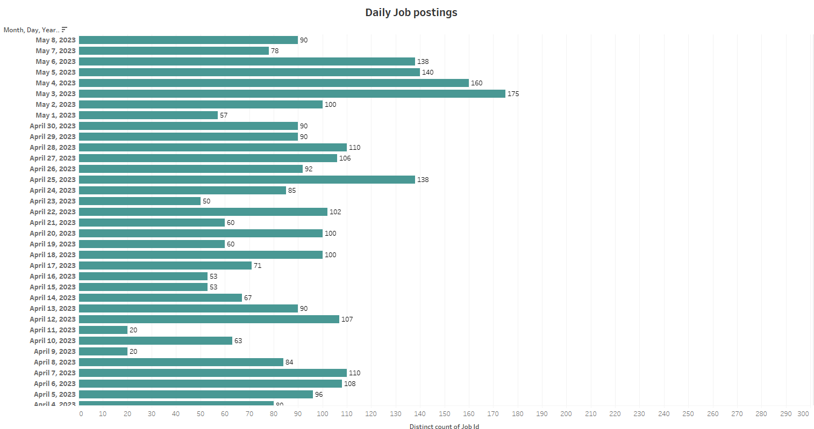

Slide 4
ETL
ETL-Extract Transform and Load
Definition through diagram:
Source
Transform
Target

Slide 5
ELT
ELT:Extract Load and Transform
Definition through diagram:
Source
Target
Transform in target DWH

Slide 6
Procedure of our ELETL
Block Diagram:
Data quality check
Transformation
DWH(Facts and Dimensions)
Raw data and API
Staging

Slide 7
Advantages
Data Quality Check
Data Quality Control
Future Work
Performance
Analysis

Slide 8
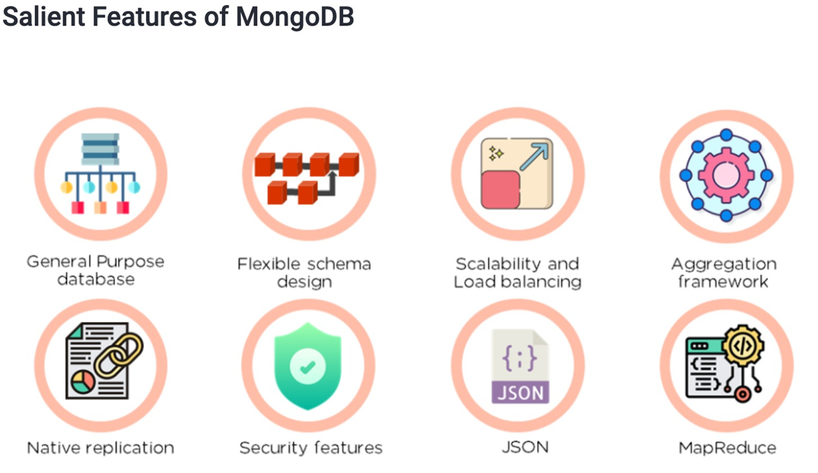
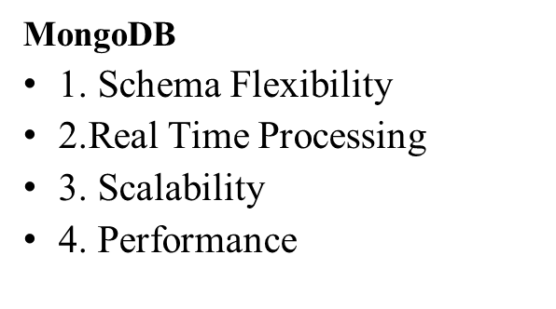
Cloud SQL/NOSQL

Slide 9
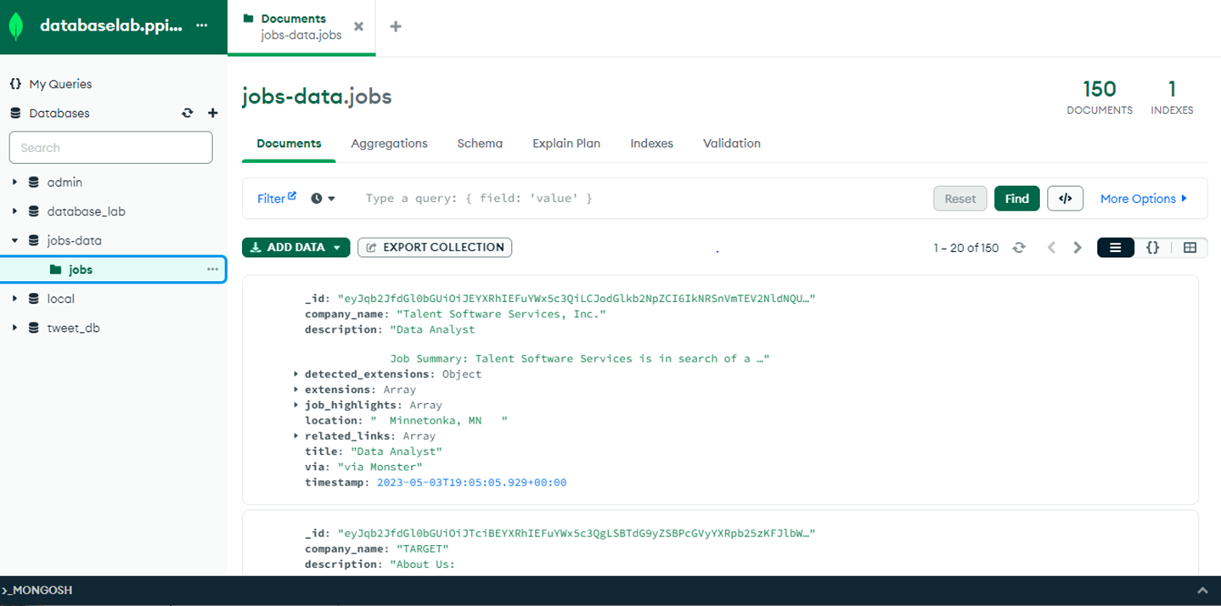
MongoDB Atlas

Slide 10

ETL Pipeline With MongoDB

Slide 11
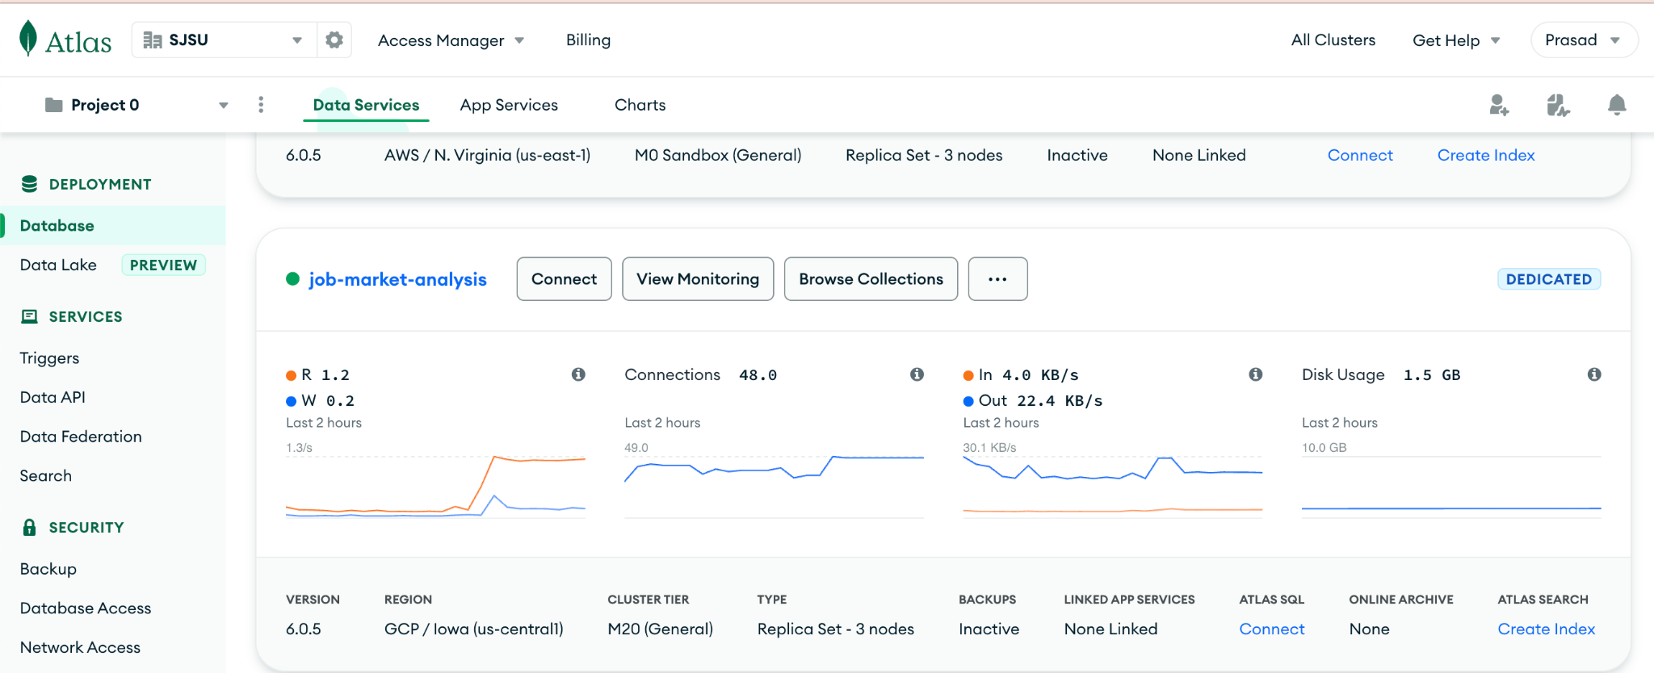
Dedicated MongoDB Atlas

Slide 12
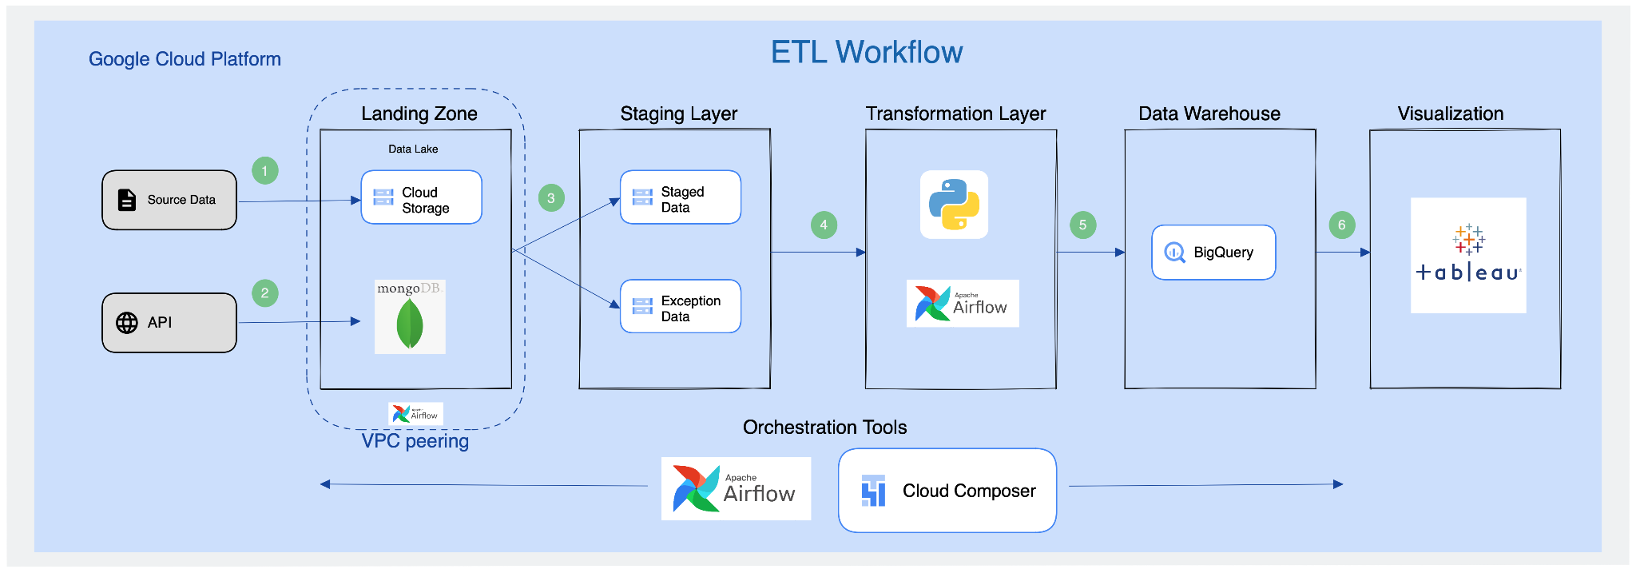
Cloud Architecture

Slide 13
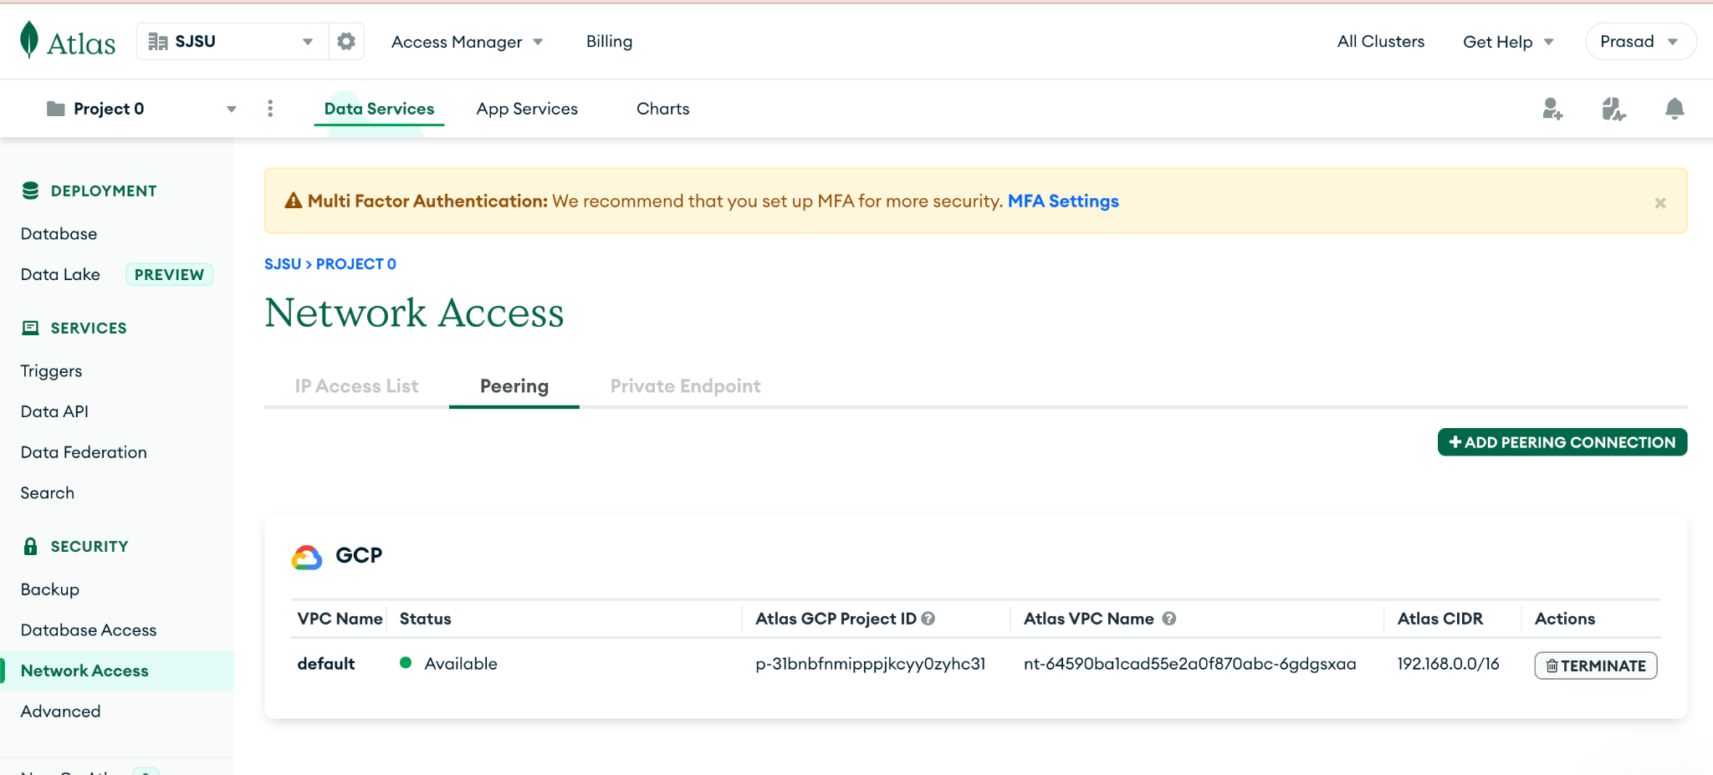
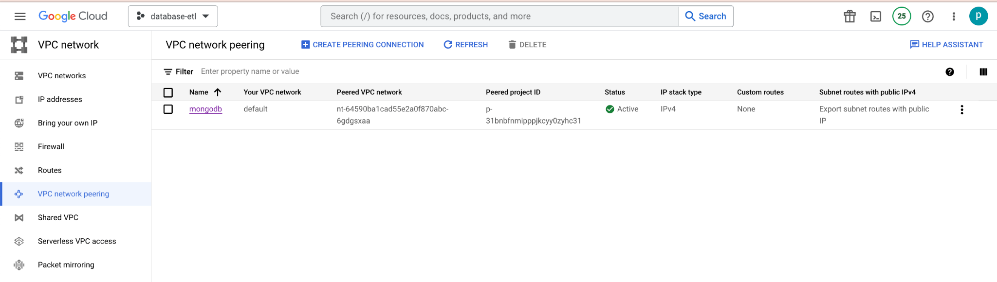
VPC peering

Slide 14
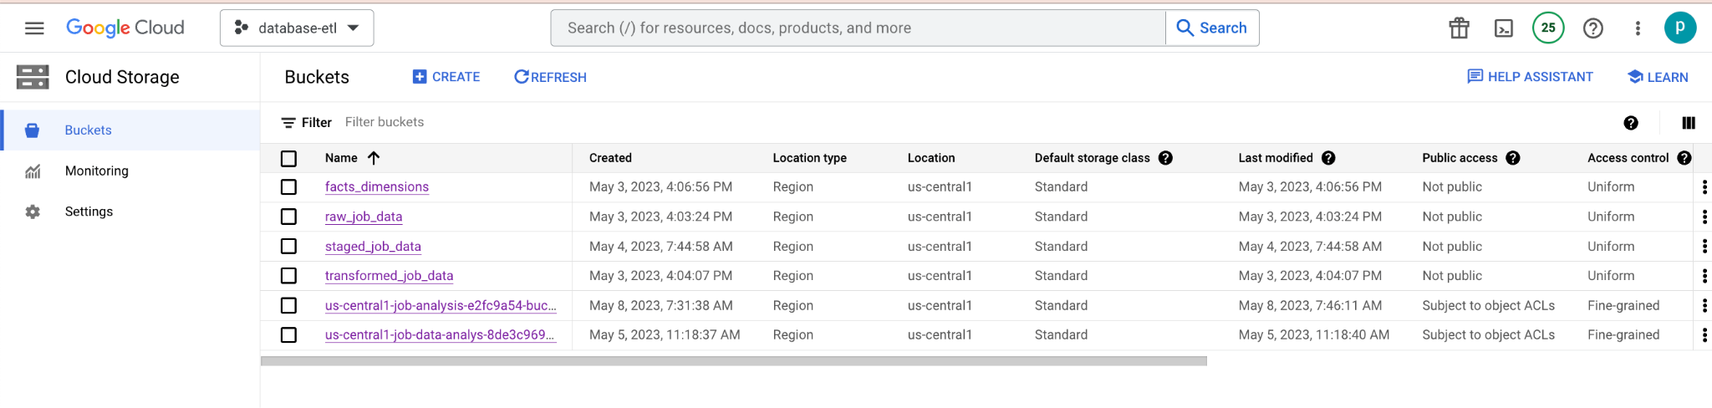
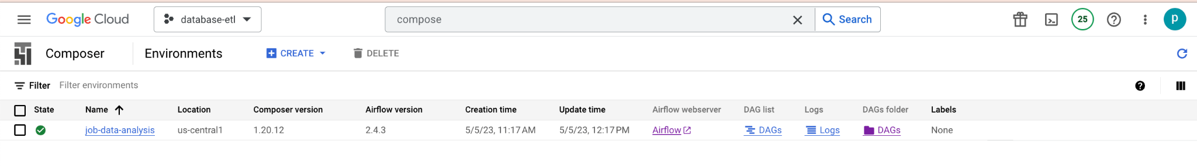
Cloud components

Slide 15
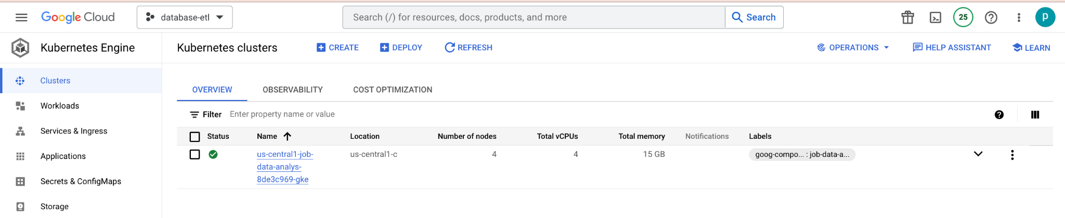
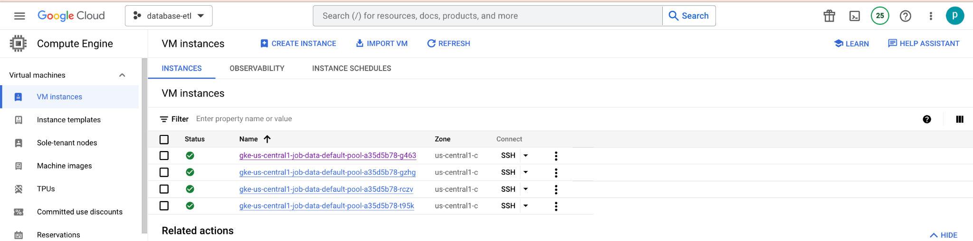
Cloud components

Slide 16
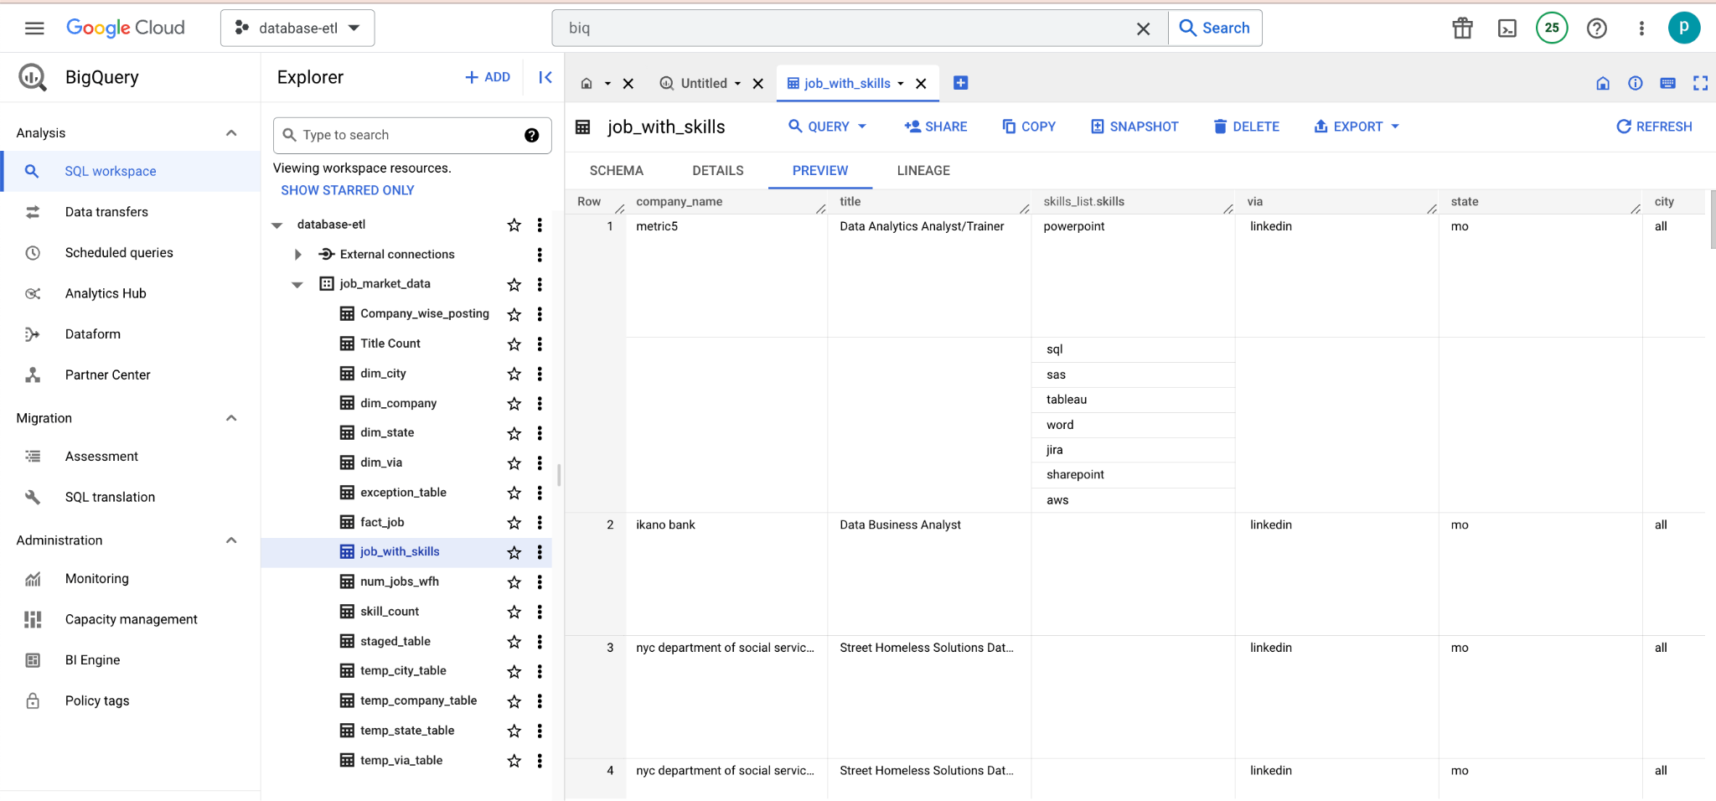
Cloud components

Slide 17
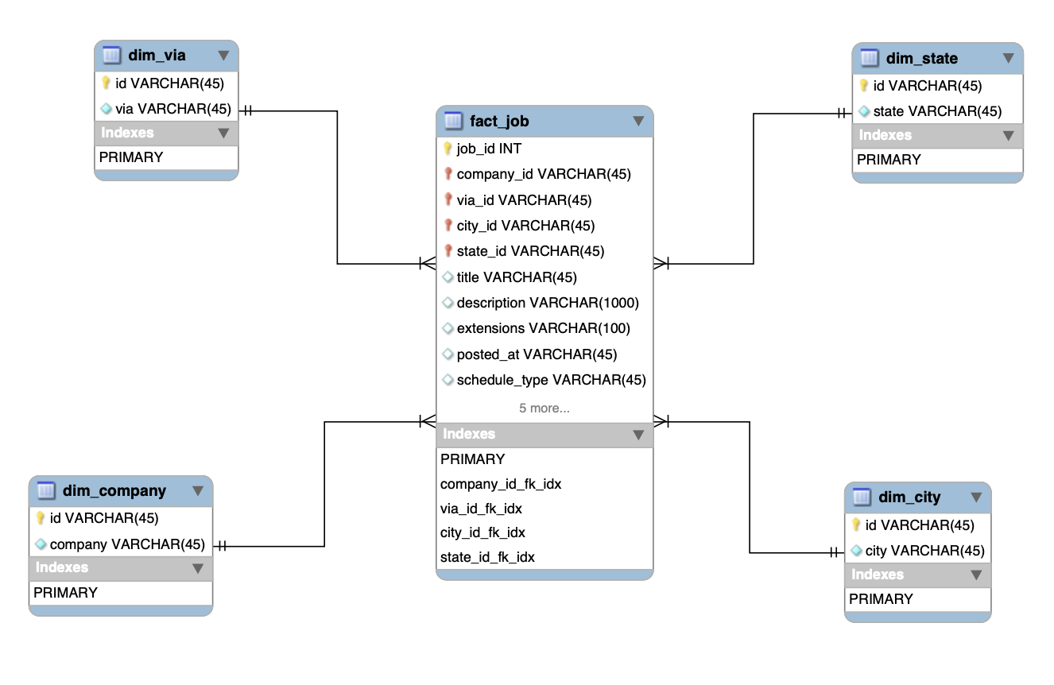
BigQuery schema

Slide 18
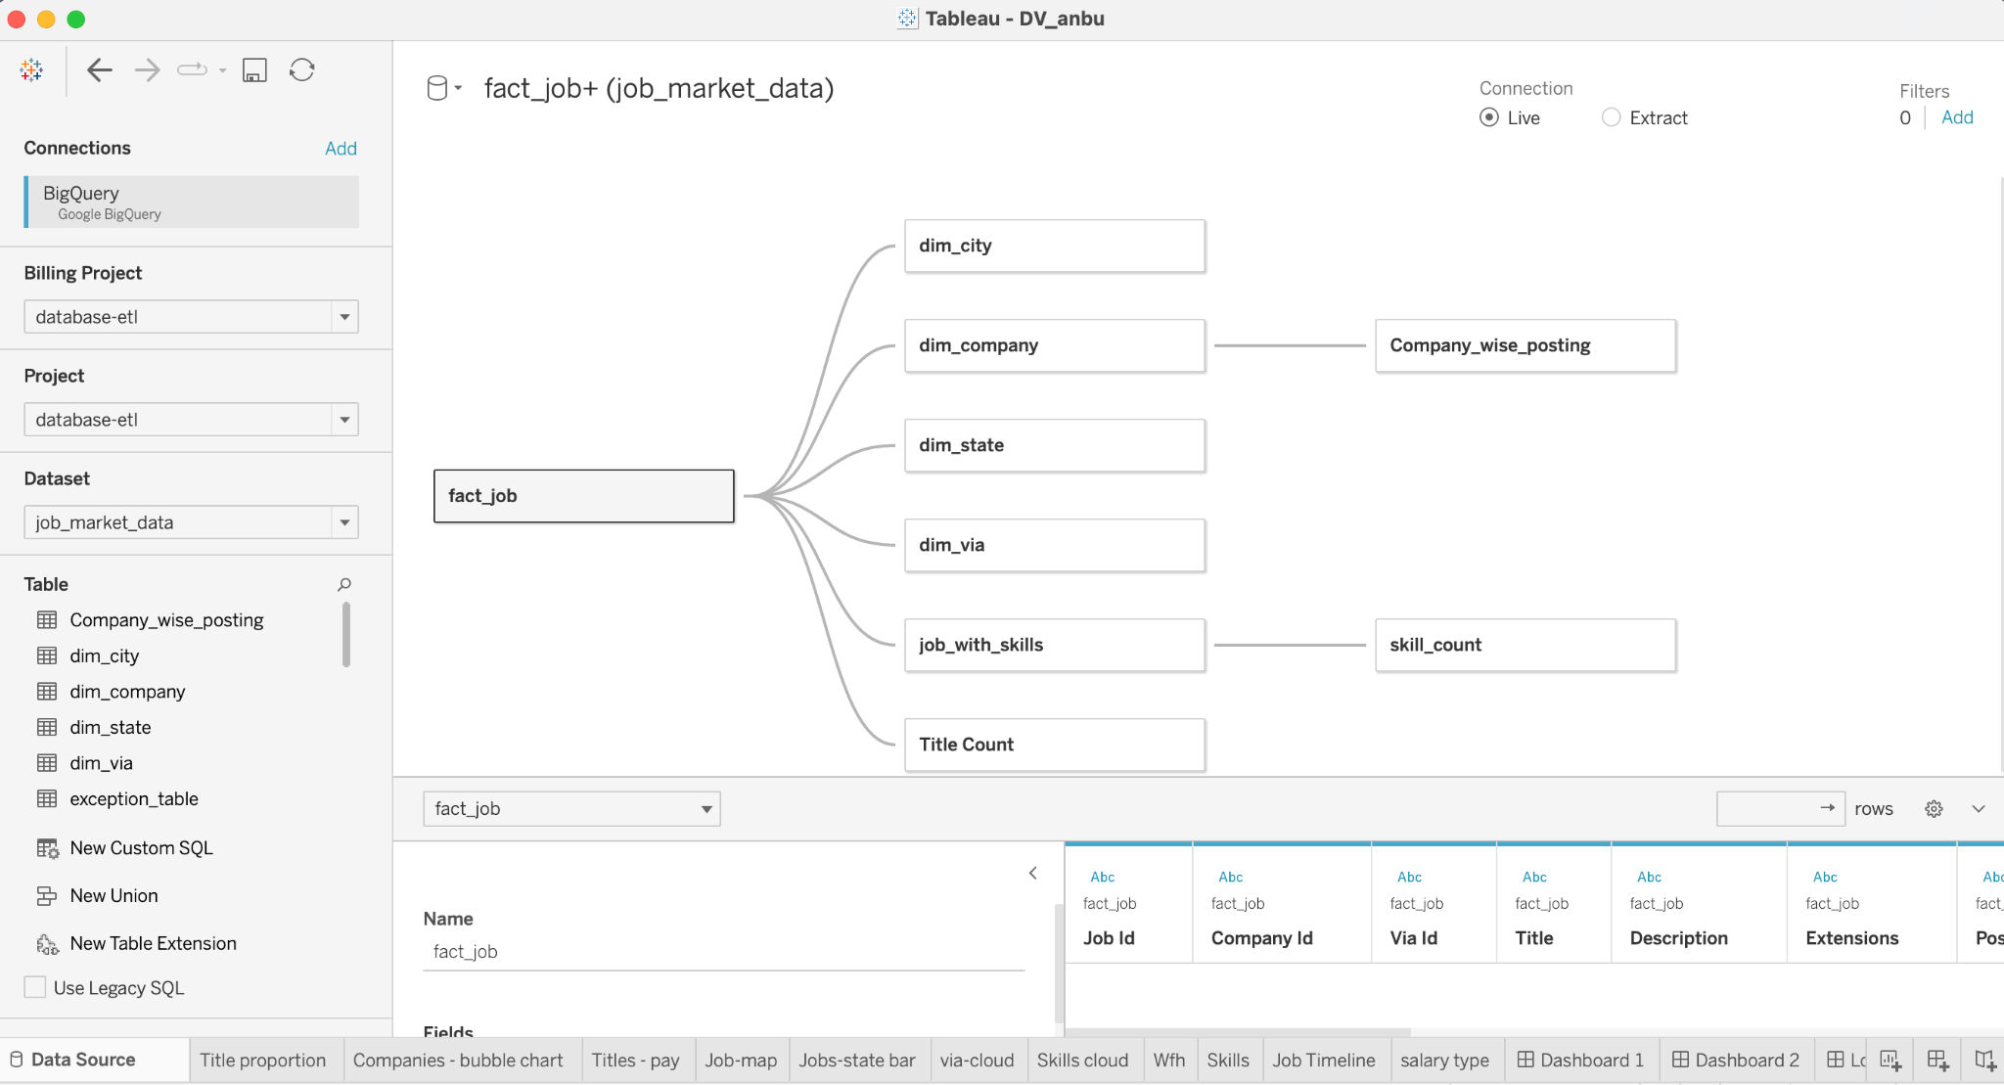
Visualization tool

Slide 19
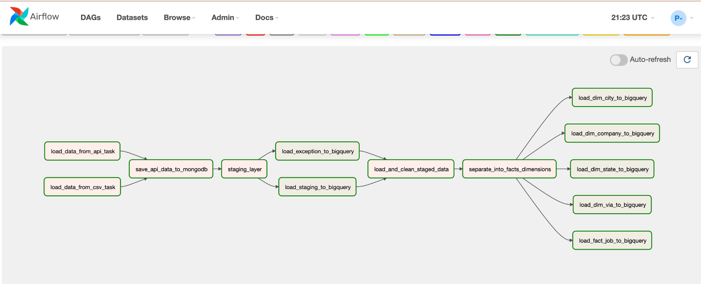
Airflow - graph

Slide 20
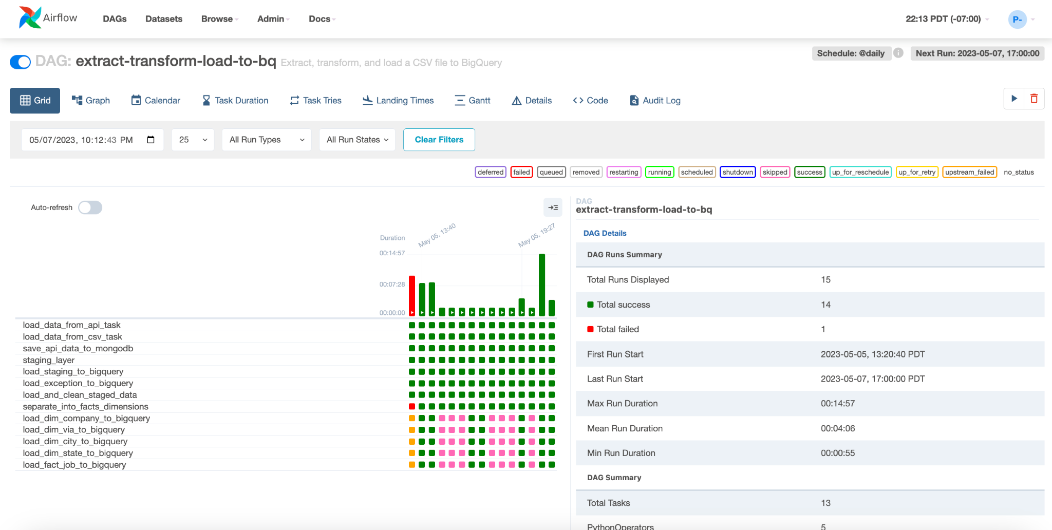
Airflow Features
1. Scheduled (daily)

Slide 21
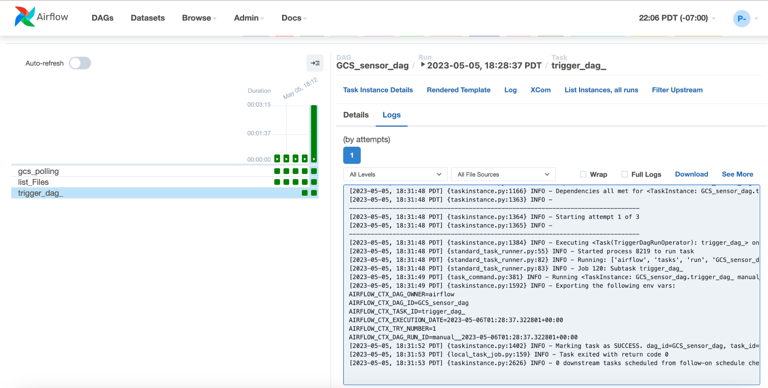
Airflow Features
2. GoogleCloudStorageObjectUpdatedSensor

Slide 22
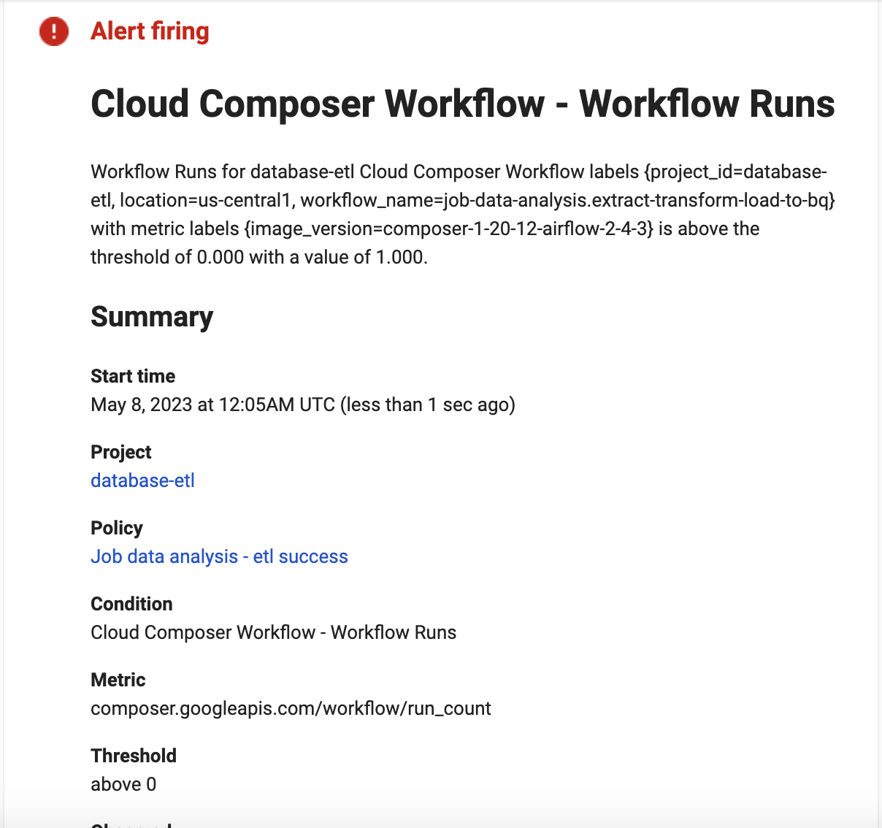
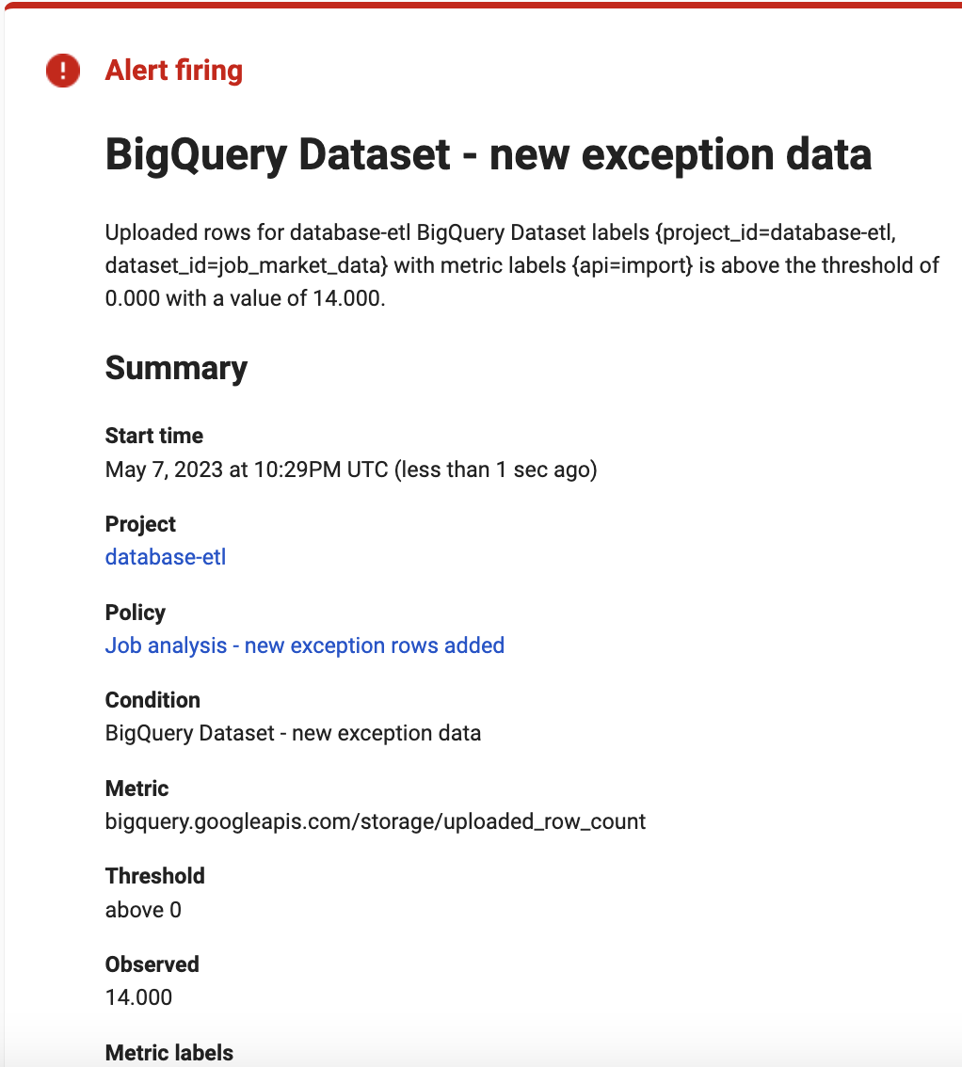
Airflow Features
3. Mail alerts (success, failure and exceptions)

Slide 23
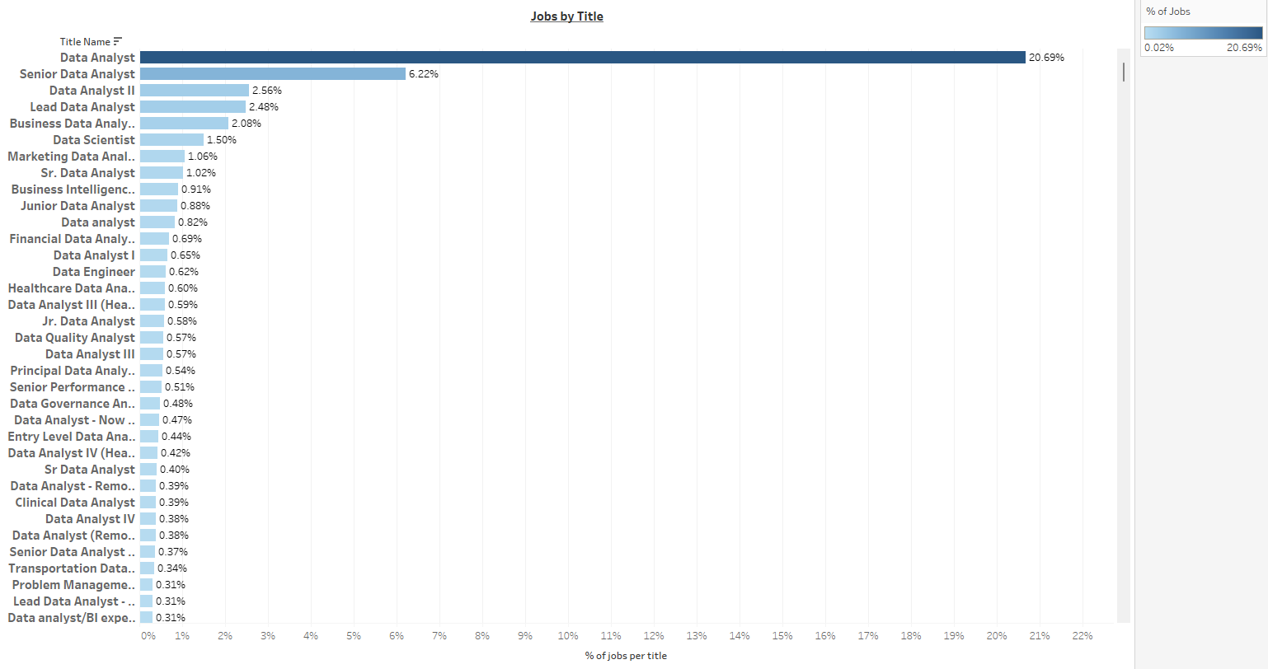
Key Performance Indicators
Number of Job Postings

Slide 24
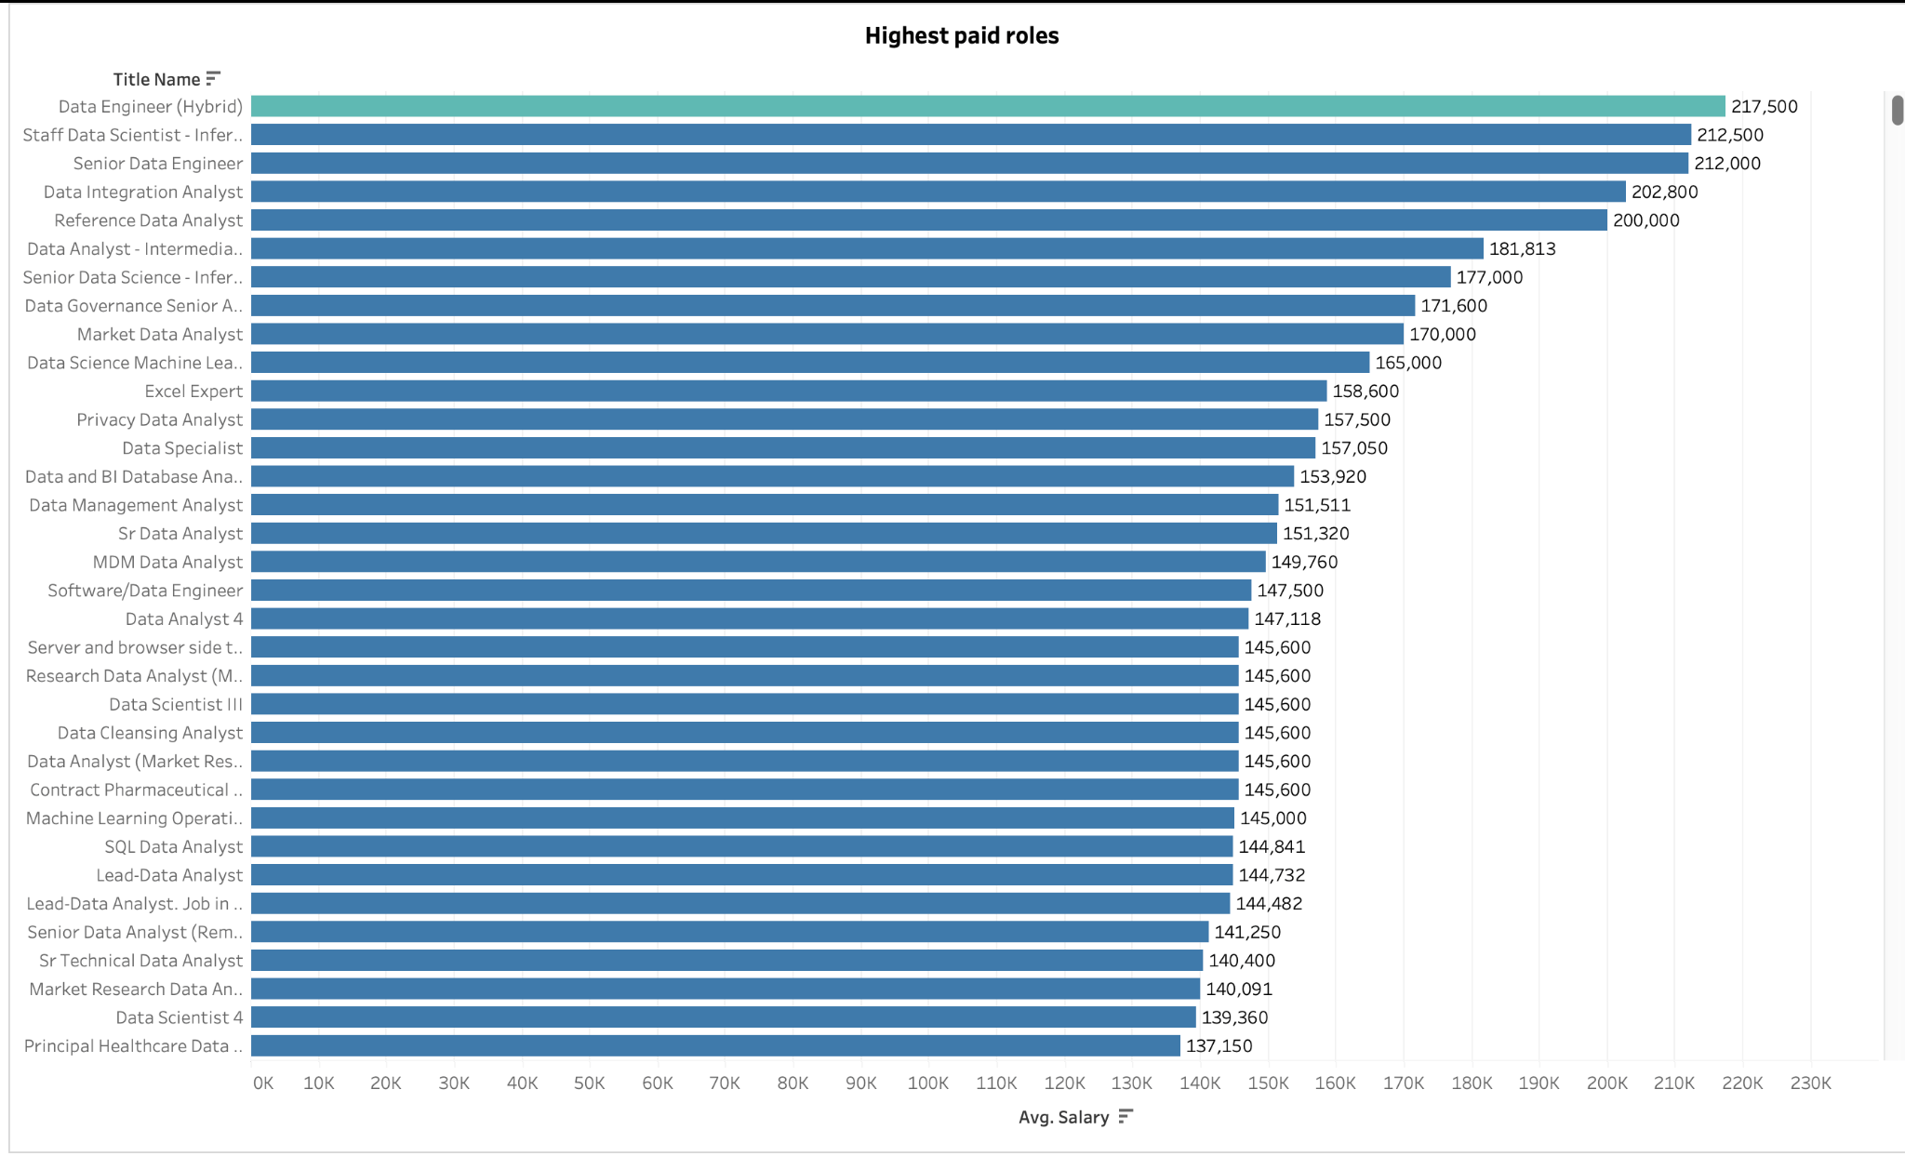
2. Salary range

Slide 25
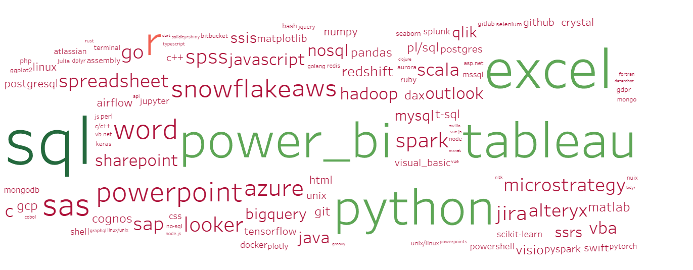
3. Required Skills

Slide 26
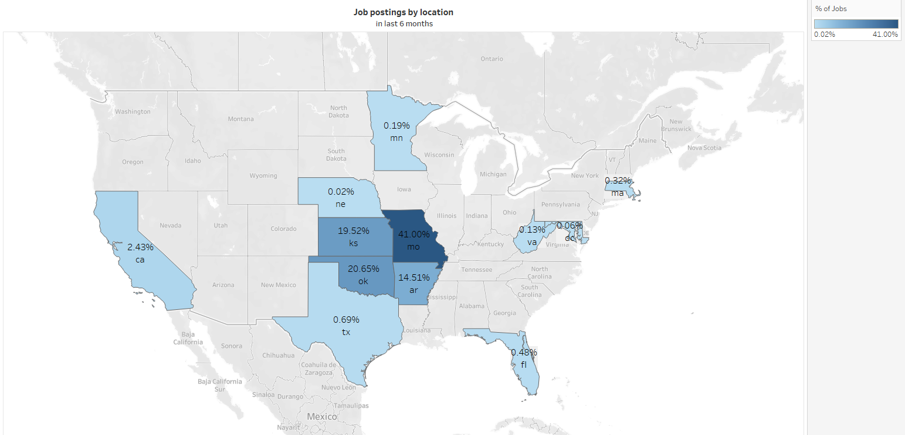
4. Job location

Slide 27
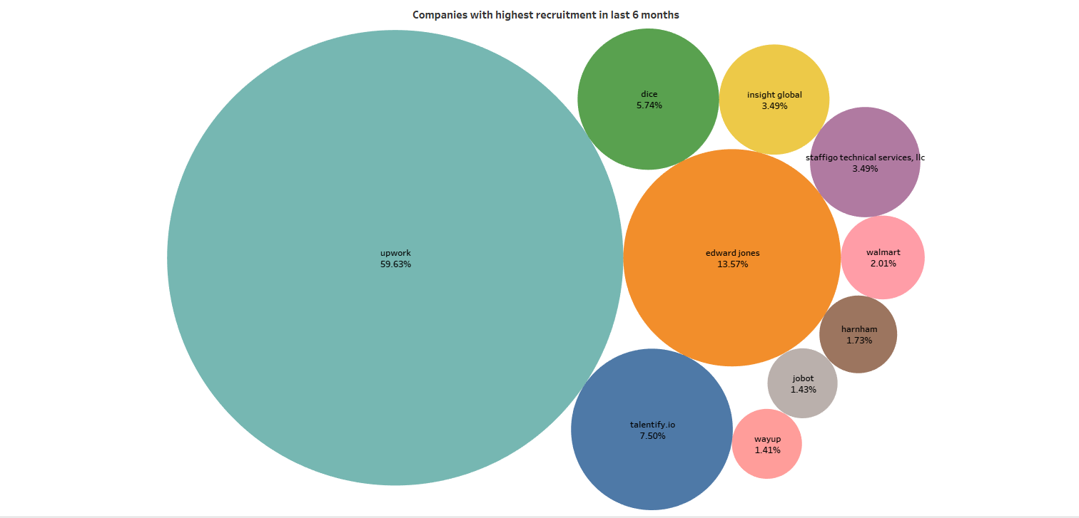
5. Company Size

Slide 28
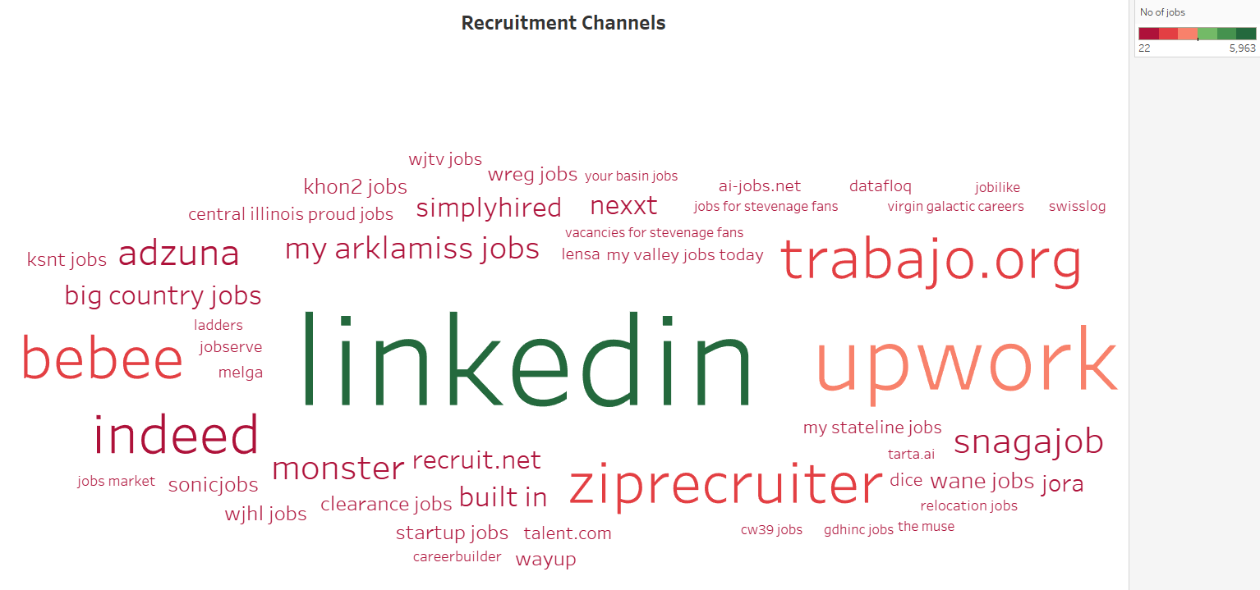
6. Recruitment Channels

Slide 29
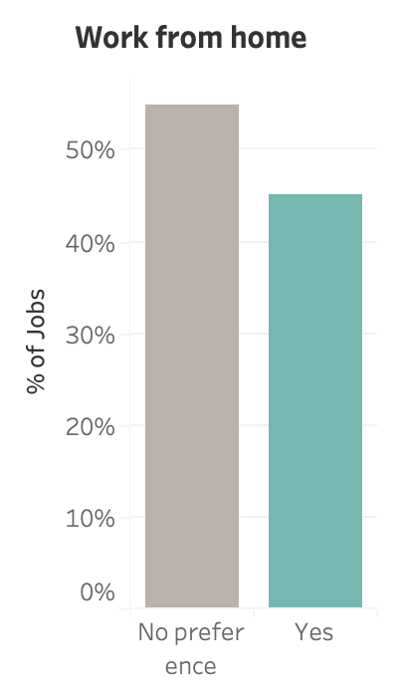
7. WFH Availability

Slide 30
Conclusion
Analytics
Querying and Visualization based on relevant KPIs for reporting and business intelligence
1
Warehousing
Cloud storage for cleaned data that offers security, scalability, reliability and ease of further processing
2
ETL Processing
Data aggregation from sources and pipeline building using workflow management tools
3
Successful Implementation of a Cloud Based Data Analytics and Warehouse Solution for Present Day Use Cases

Slide 31
Thank You

